Slide 1
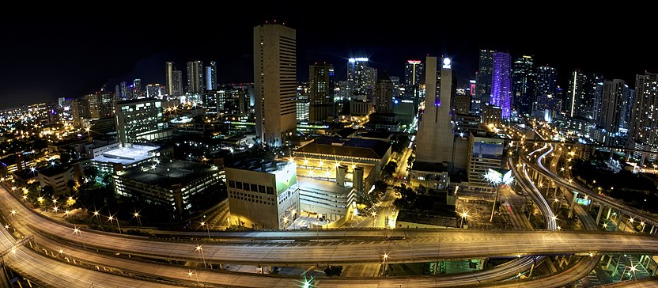
Miami’s 10 Coolest Neighborhoods

Slide 2
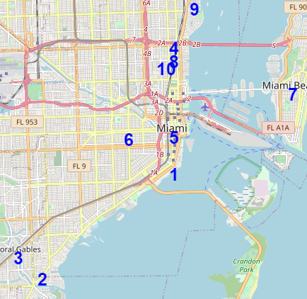
According to culture trip these are Miami’s 10 coolest neighborhoods:
1) Brickell,
2) Coconut Grove,
3) Coral Gables,
4) Design District,
5) Downtown,
6) Little Havana,
7) Miami Beach,
8) Midtown,
9) Upper Eastside,
10) Wynwood

Slide 3
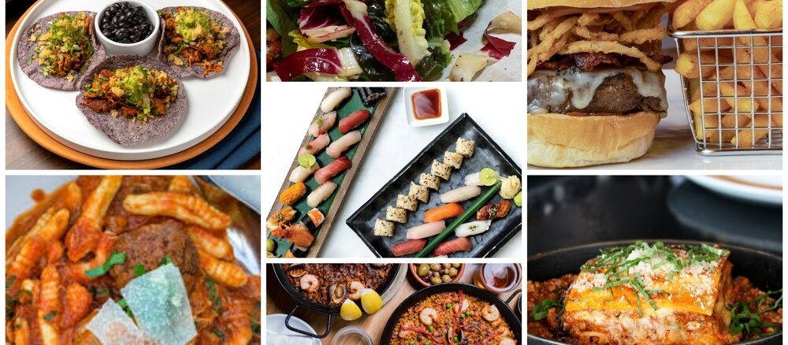
What are the percentage of types of restaurants in each neighborhood?
Anyone wishing to open a restaurant in one of the trendiest Miami neighborhoods would like to know the answer.

Slide 4
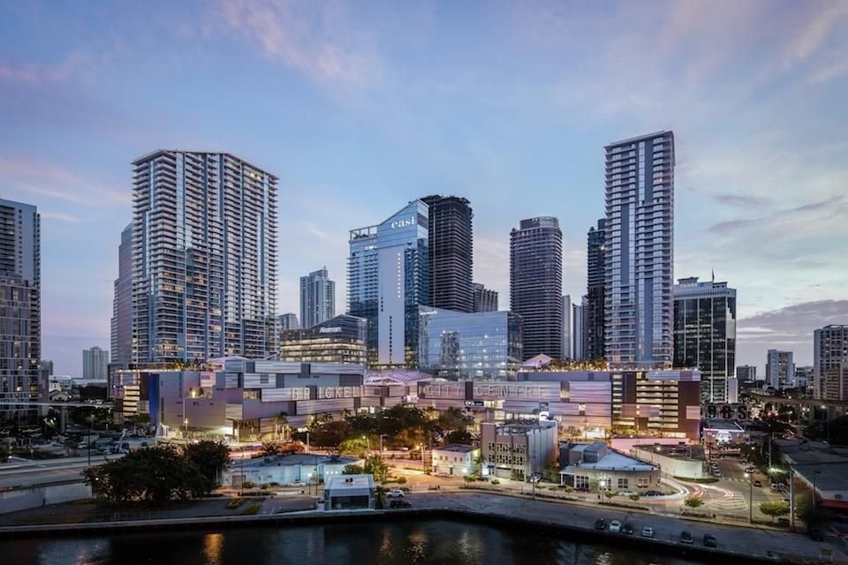
Brickell:
Percentage of Restaurant Types:
American 27%
Argentinian 10%
Japanese 10%
Cafe 7%
Italian 7%
Salad 7%
10 others 3%

Slide 5
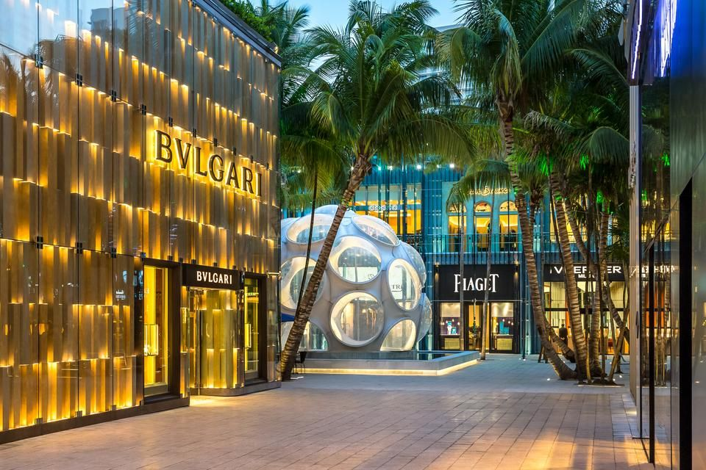
Design District :
Percentage of Restaurant Types:
American 20%
Pizza 20%
Sandwich 13%
Tapas 13%
Bistro 7%
Breakfast 7%
Cuban 7%
Food Truck 7%
French 7%

Slide 6
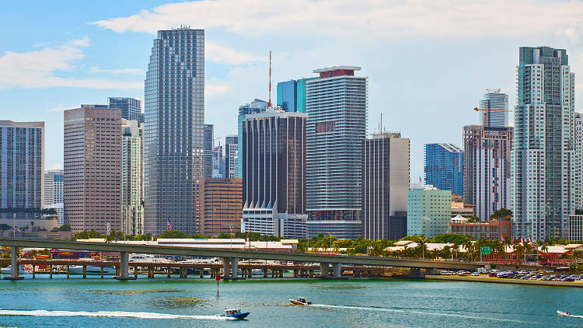
Downtown:
Percentage of Restaurant Types:
Italian 12%
Sandwich 10%
Peruvian 10%
Café 8%
Greek 8%
American 5%
Brazilian 5%
Pizza 5%
New American 5%
Many others at 2%

Slide 7
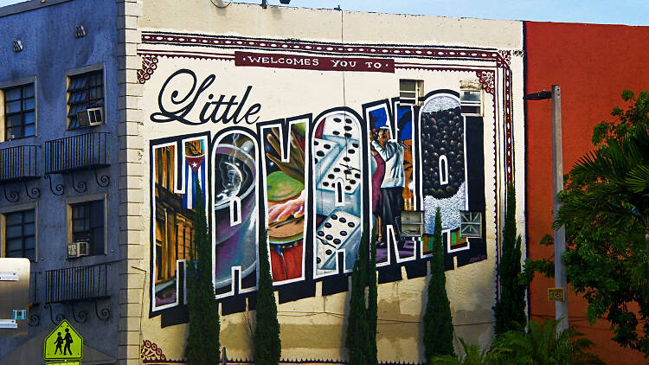
Little Havana:
Percentage of Restaurant Types:
Latin American 38%
Bakery 15%
Chinese 8%
Deli/Bodega 8%
Mexican 8%
American 8%
Spanish 8%
Taco 8%

Slide 8
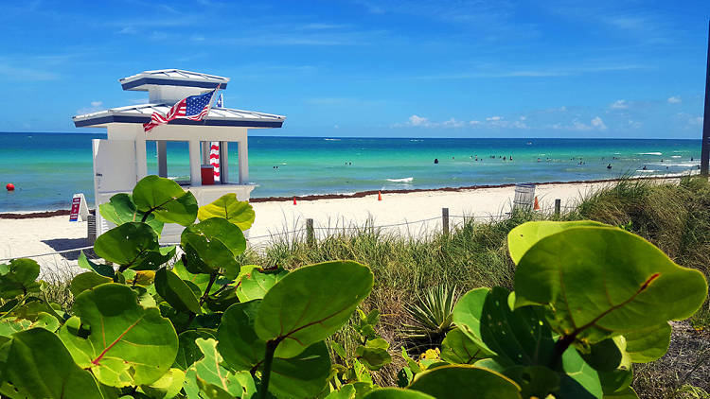
Miami Beach:
Percentage of Restaurant Types:
Pizza 16%
Italian 13%
Cuban 13%
Tapas 6%
Café 6%
Food Court 6%
Many others at 3%

Slide 9
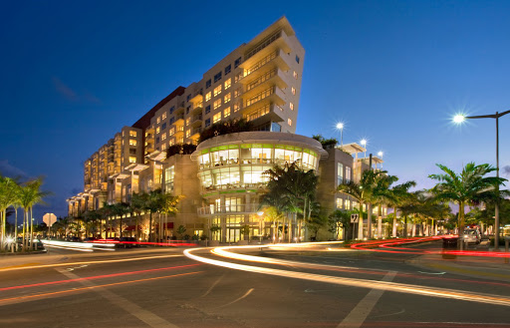
Midtown:
Percentage of Restaurant Types:
American 9%
Seafood 7%
Pizza 7%
Italian 7%
Greek 5%
Indian 5%
South American 5%
Bakery 5%
Sandwich 5%
Peruvian 5%
Mexican 5%
Japanese 5%
Many others at 2%

Slide 10
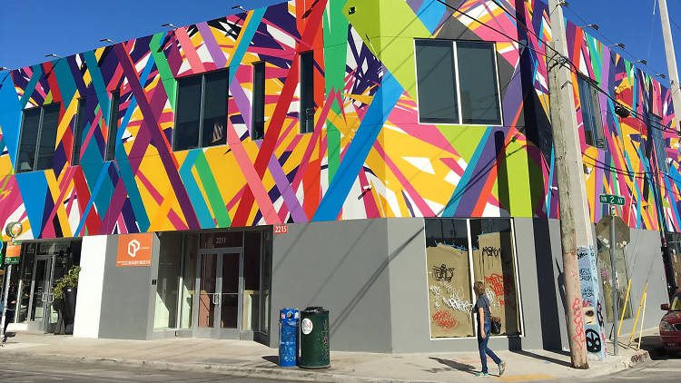
Wynwood:
Percentage of Restaurant Types:
Food Truck 14%
American 12%
Café 10%
Mexican 6%
Asian 4%
Pizza 4%
Peruvian 4%
New American 4%
Caribbean 4%
Bakery 4%
Vegetarian 4%
Many others at 2%

Slide 11
The following neighborhoods were not included due to very few restaurants in the data:
Coconut Grove, Coral Gables, and Upper Eastside

